Slide 1
Use of BIM Might Facilitate Risk Management
T1226 Part3

Slide 2
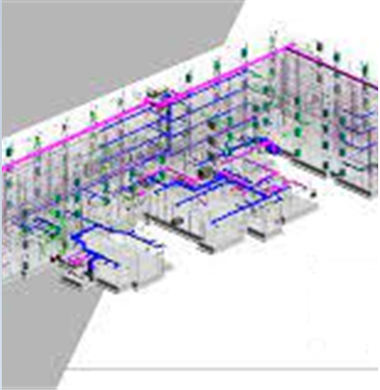
Introduction
Building Information Modeling (BIM)
Customer ease
Greater opportunities
Agile and accurate
Notes:
Architects, engineers, and contractors (AEC) rely on Building Information Modeling (BIM) to drive digital transformation of their businesses. Autodesk, the industry leader in BIM, helps businesses and the built environment realize better ways of working.
By using BIM, customers are able to visualize a construction from both their own perspective and from a performance standpoint by combining computer animation and virtual flythroughs of railway tracks.
As a result, there is a greater opportunity for engagement between the client, design team, and other stakeholders at this early stage, leading to more informed decisions (Barnes, 2020).
The model's area information helps quantity surveyors and clients calculate design costs more quickly and accurately.

Slide 3
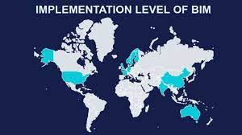
Skyrocketing BIM usage
Dodge Data & Analytics
Digital transformation
Requirement of US
Laws in technology sector
Notes:
The Dodge Data & Analytics report describes the industry at a tipping point, with most BIM-using firms now using BIM on over half of their projects, driving digital transformation across the sector.
But it's vital to note that in the US, BIM is not a requirement of the federal government. Contrary to nations like the UK and Singapore, which have rigorous regulations for the usage of the technology, the technology is not yet required for public projects.

Slide 4
Adoption by businesses
Site safety needs
Strong demand by US
Costing more than $5 million USD
Delayed adoption
Notes:
Instead of due to a legislative need, the system has been adopted by US businesses due to its advantages in efficiency, lowering material waste, and enhancing site safety (Mochal & Mochal, 2011).
Although there is a strong demand for the federal government to compel its usage in public projects costing more than $5 million USD, the US lacks a central government body in charge of overseeing civil engineering and infrastructure projects.
This might be a factor in the delayed adoption of its nationality (Barnes, 2020)..

Slide 5
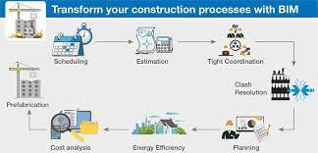
Industry Impact of BIM Methodology
Strong grip of BIM
Use in Mega projects
Necessity for construction sector
Freedom tower in NY city
Notes:
In significant projects around the nation, BIM has established a strong grip.
Even while BIM is frequently used in bigger projects like infrastructure and civil engineering, its application in private building contracts and even residential construction is growing as the advantages of adoption expand and the cost declines.
Engineers and architects have been able to push the envelope of design while still completing projects on schedule by positioning themselves as a cornerstone necessity for construction.
The One World Trade Center in New York City, also known as the Freedom Tower, served as a notable example of this.
With a height of 1,776 feet and a design that was nearly entirely created using 3D modelling, it is one of the most complicated buildings ever finished in the US due to its sheer scale and operational requirements.

Slide 6
Bim accelerates digital-transformation
Increased BIM usage
Increased awareness in corporate sector
Satisfied customers
Quality of design
Low risk
Minimum mistakes
Increased benefits of BIM over utilization
Digital transformation necessity
Notes:
There is one main factor driving the rise in BIM usage. BIM is accelerating digital transformation, thanks to its rising and an increase in the adoption of emerging technologies.
Companies are becoming more aware of the significant commercial benefits that come with a digital transformation, including increased customer satisfaction, design quality, decreased risk, fewer mistakes and rework, and significant gains in operational efficiency and sustainability.
However, it goes beyond adoption. The benefits of BIM increase as you utilise it more.
A company's BIM intensity (i.e., the proportion of its projects that use BIM) directly correlates with the status of its digital transformation and the extent to which it reports reaping rewards from BIM investment and ROI.
BIM is a crucial step in the process of going through a digital transformation. Nearly half (47%) of heavy BIM users are getting close to the objective.

Slide 7
More possibilities and opportunities
Enhanced workflows and procedures
Cloud based technologies
Innovative approaches
Notes:
It provides possibilities to find recurring problems or common bottlenecks throughout the whole project portfolio of the organisation and to establish new workflows and procedures to go around them in the future. BIM is transforming the landscape of a technology-resistant construction industry by enabling and enhancing procedures (Habibi lasiby et al., 2021).
Greater developments in BIM include cloud-based technologies driving design and construction teams working in new, innovative ways.

Slide 8
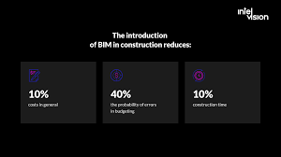
How BIM reduce the probability of errors
Information modelling
Intelligent and collaborative 3D modelling
Structural and functional elements
Accurate knowledge and resources
Improved resource management
Improved communication
Notes:
Building information modelling, or BIM, is a highly intelligent and collaborative 3D model-based approach for managing information throughout the lifecycle of a construction project.
The technique contains information about a model's structural and functional elements, providing architects, engineers, and builders with the knowledge and resources they need to plan, design, and build in a more efficient, quick, and environmentally friendly manner.
The construction sector has greatly benefited from improved resource management and communication thanks to BIM. That's not all, though. The approach provides a way to determine which components to include in order to minimise waste and to calculate the precise material requirements.

Slide 9
Conflict detection
Correction of design flaws
Decreased wastage and low costs
Low cost risk
4D simulation
Notes:
Conflict detection is a feature of BIM visualisation approaches that enables the early detection and correction of design flaws.
BIM can decrease waste and keep costs low throughout the pre-construction stage, (Moshtaghian & Noorzai, 2022) which lowers the likelihood of cost risks and missed deadlines.
By enhancing the logistics on the construction site, the usage of Building Information Modelling (BIM) can assist in lowering the cost of construction.
BIM can provide 4D simulations that depict the building's construction process throughout time.

Slide 10
Mistakes in BIM Implementation
Lack of BIM-execution-Plans
Utilising hosting techniques and unsuitable hardware
Inaccurate building information
Over-modelling
BIM coordinator must not be the project leader
Differences in modelling
Quality checks
Weak team members
Notes:
The key to a good BxP is the simplicity of the layout. Some BxP is so overthought and complex that they become impossible to implement and are soon forgotten.
Need the right tool and technology depending on the software you are using and the requirement of the project.
It provides the end-users with critical information like cost estimation.
BIM technology and software are constantly evolving and revamping.
Avoid modeling down to the last element like nuts which won’t be even visible on the drawing.
Architecture “Redlines” has been an age-old standard practice in architecture history to signify the correction and scope of improvement in design (Victor, 2022).

Slide 11
References
Barnes, P. (2020) “An overview of project management and the ProjectManager’s roles in respect of bim,” BIM for Project Managers, pp. 15–22. Available at: https://doi.org/10.1680/bimpm.65291.015.
Barnes, P. (2020) “The BIM management roles,” BIM for Project Managers, pp. 33–38. Available at: https://doi.org/10.1680/bimpm.65291.033.
Habibi lasiby, negar et al. (2021) “Evaluate the effects of using BIM in improving underground project management processes,” SSRN Electronic Journal [Preprint]. Available at: https://doi.org/10.2139/ssrn.3786259.
Kim, Y.-H., Kim, H.-S. and Kang, L.-S. (2015) “A study of BIM delivery model for railway construction project using BIM function breakdown structure,” Journal of the Korean society for railway, 18(4), pp. 344–353. Available at: https://doi.org/10.7782/jksr.2015.18.4.344.
Mochal, T. and Mochal, J. (2011) “Evaluate all risk response options in the risk plan,” Lessons in Project Management, pp. 161–164. Available at: https://doi.org/10.1007/978-1-4302-3835-5_39.
Moshtaghian, F. and Noorzai, E. (2022) “Integration of risk management within the building information modeling (BIM) framework,” Engineering, Construction and Architectural Management [Preprint]. Available at: https://doi.org/10.1108/ecam-04-2021-0327.
Victor, L. (2022) 8 Crucial Mistakes in BIM Implementation and Ways to Tackle Them. Available at: https://www.united-bim.com/8-crucial-mistakes-in-bim-implementation-and-how-to-tackle-them/.

